Slide 1
Multi-species Catalogues of Regulatory Elements: ENCODE
Session 2
T6: Making the most of cis-regulatory annotations for genome-scale analysis
Gabriela A. Merino
Senior Bioinformatician, Ensembl Regulation, EMBL-EBI
03/09/2026

Slide 2
1
ENCODE: Experimental data

Slide 3
Hands-on

Slide 4
The ENCODE Data Portal
Answer the following questions:
How many DNase-seq experiments from human cerebellum tissue from female donors are available?
How many reference epigenomes for human hepatocytes are available?
Using the search toolbar, query for forebrain E13.5 and select the available reference epigenomes. How many experiments do they have linked? Are there any open chromatin experiments available?

Slide 5
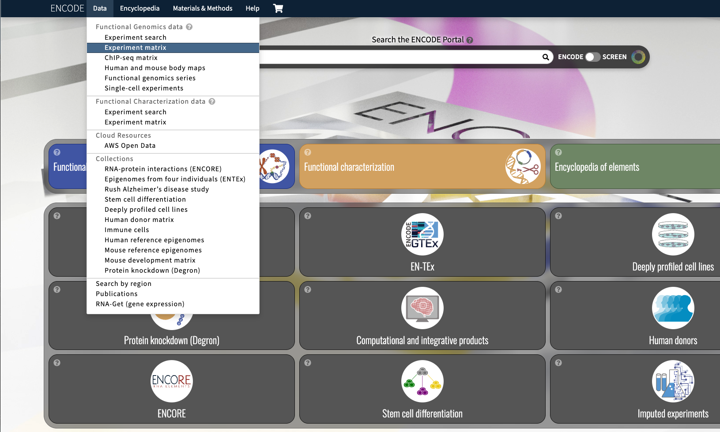
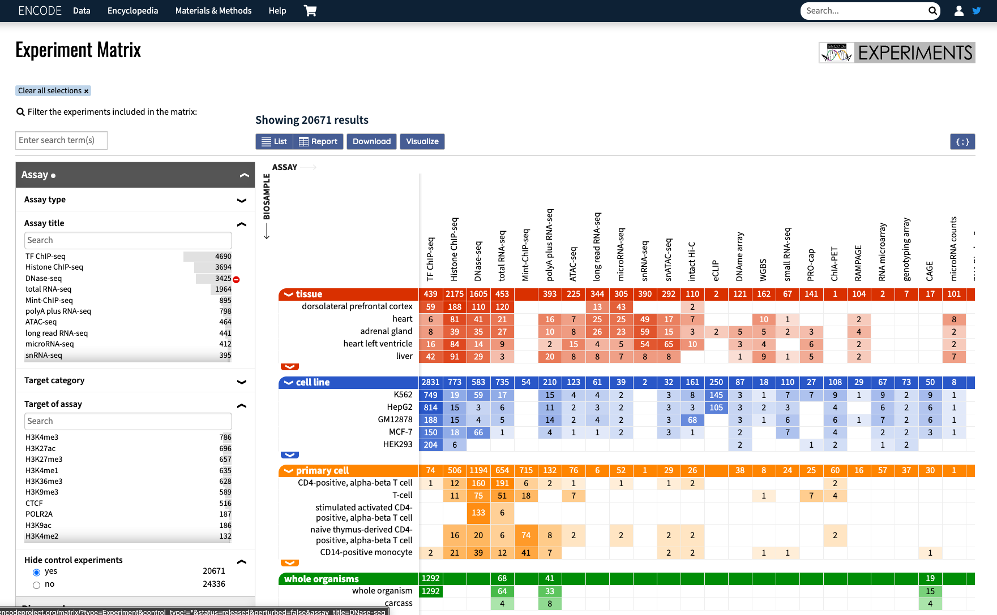
The ENCODE Data Portal
How many DNase-seq experiments from human cerebellum tissue from female donors are available?

Slide 6
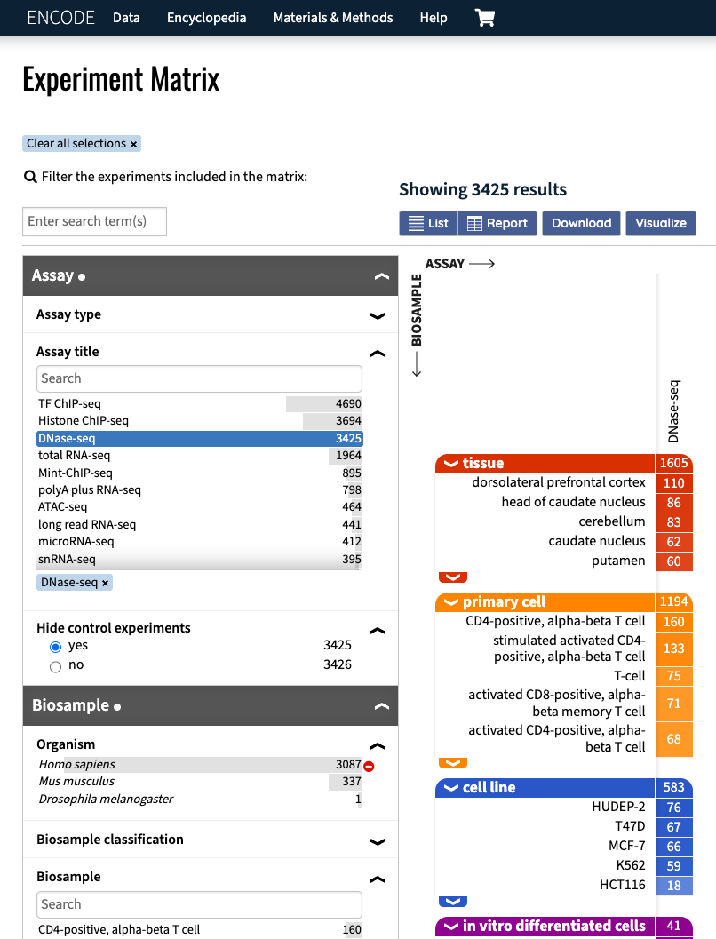
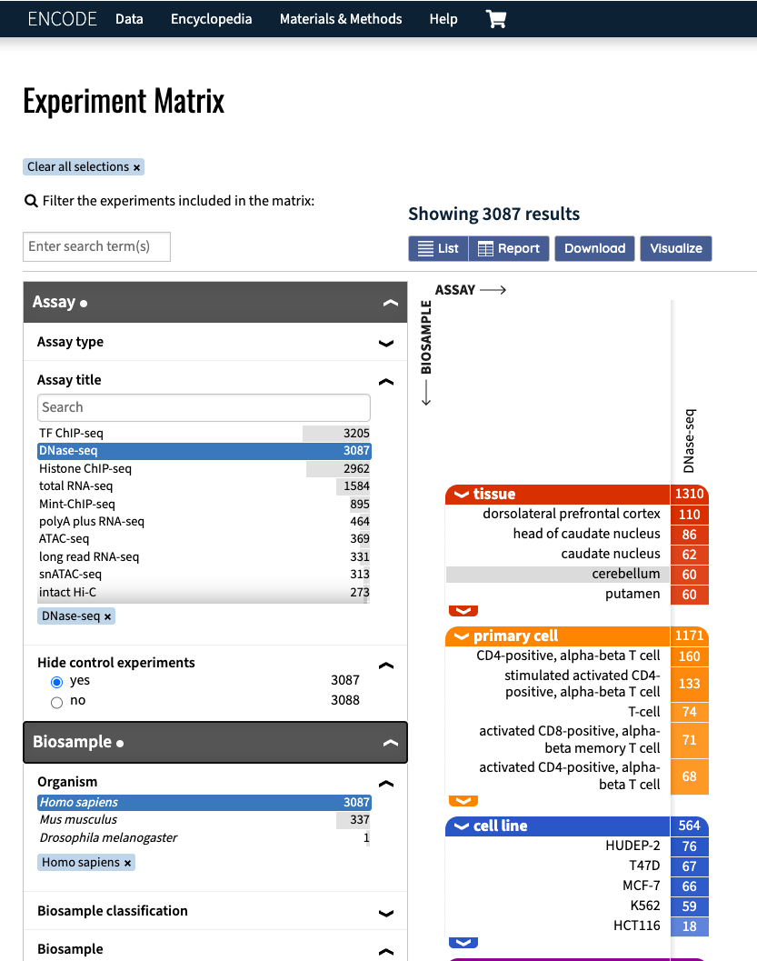
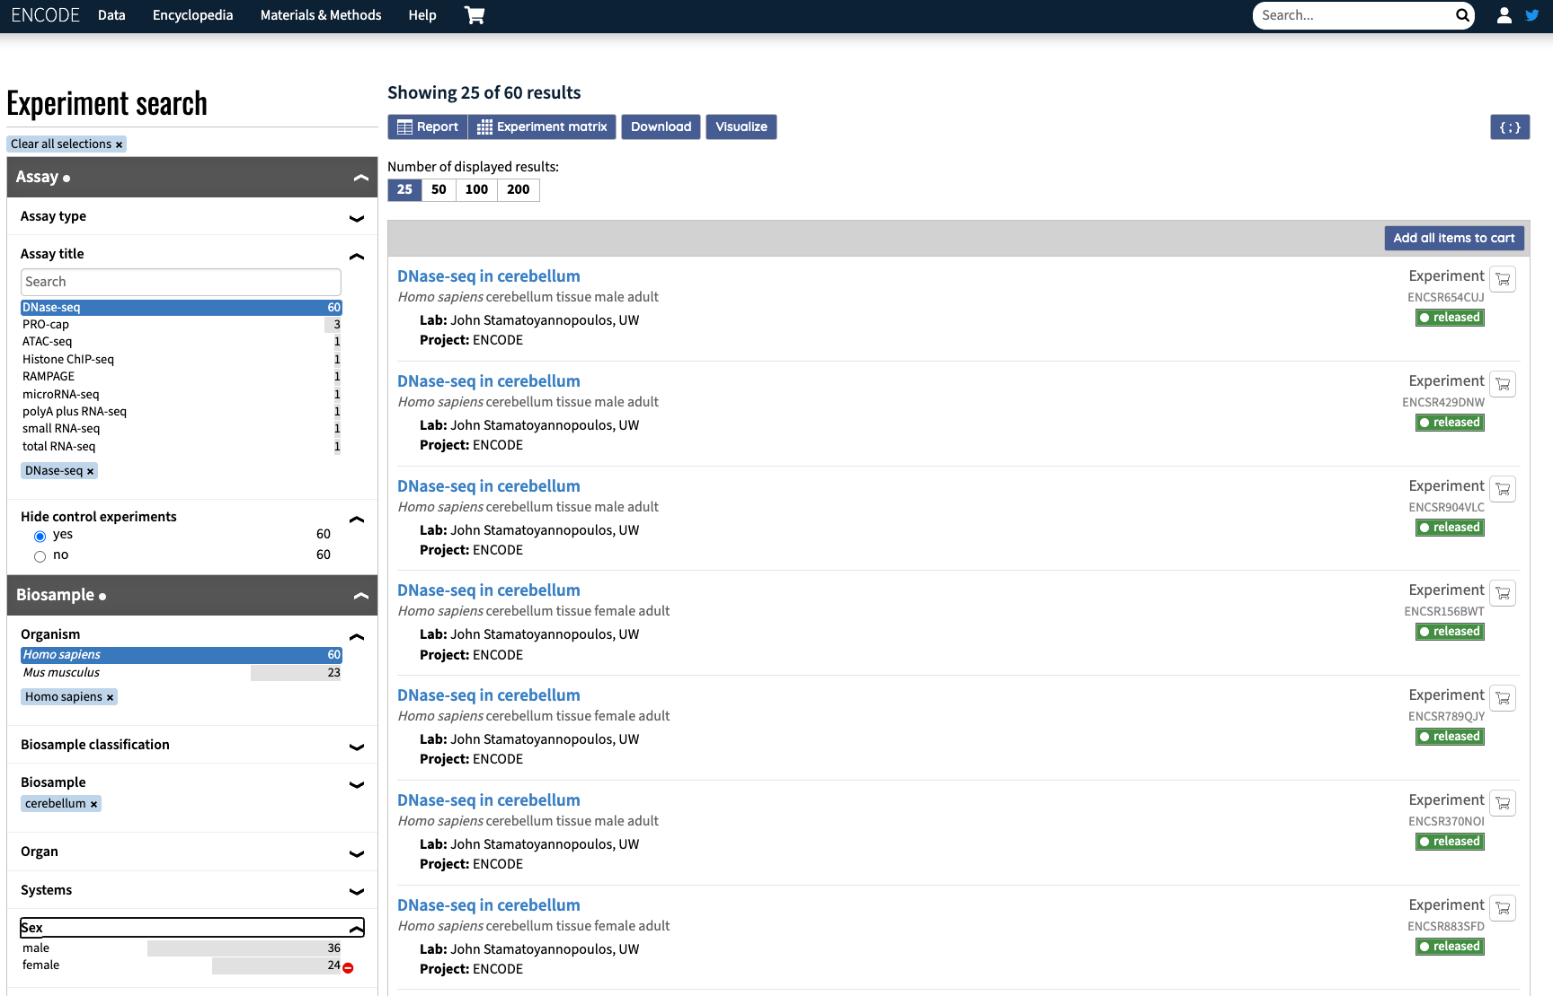
The ENCODE Data Portal
How many DNase-seq experiments from human cerebellum tissue from female donors are available?

Slide 7
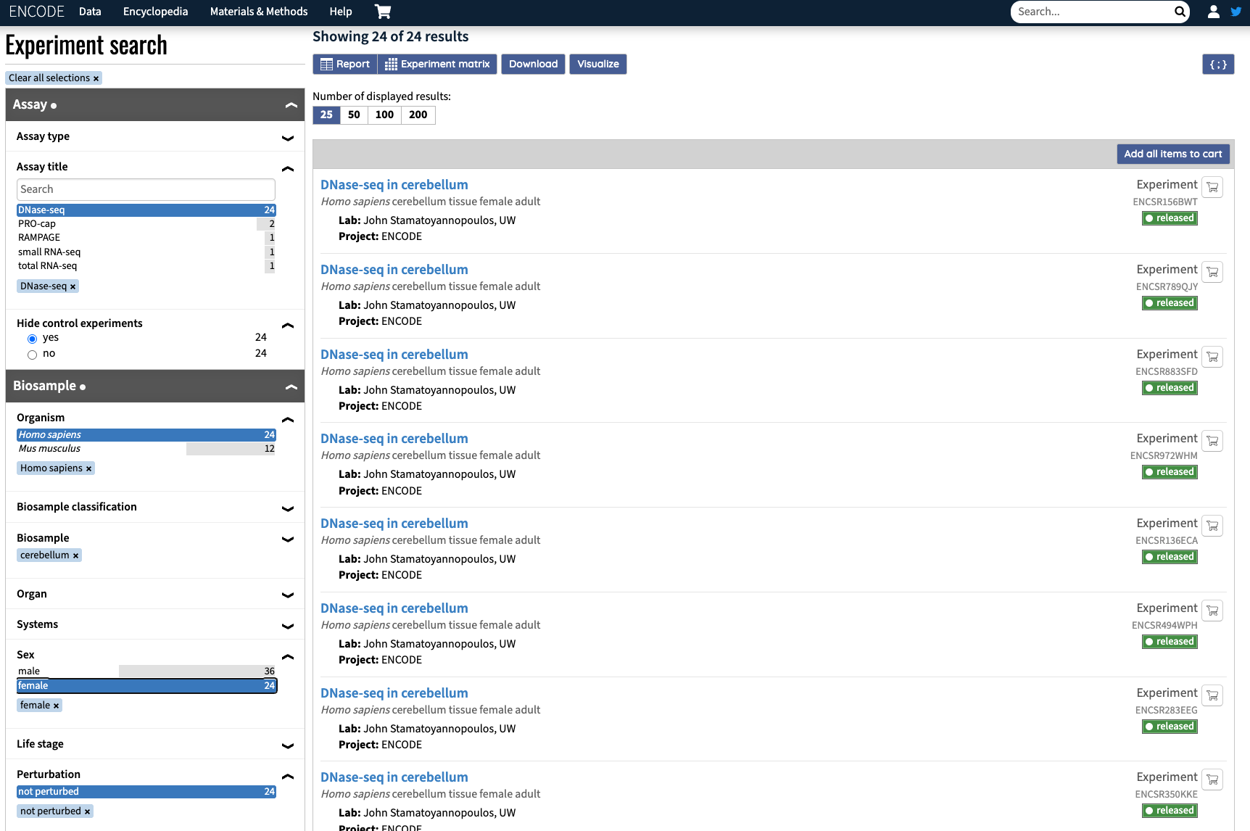
The ENCODE Data Portal
How many DNase-seq experiments from human cerebellum tissue from female donors are available?
24 experiments

Slide 8
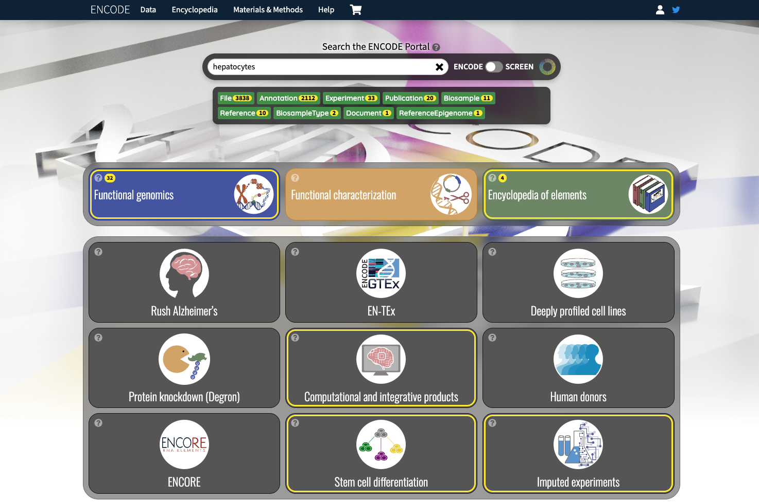
The ENCODE Data Portal
How many reference epigenomes for human hepatocytes are available?

Slide 9
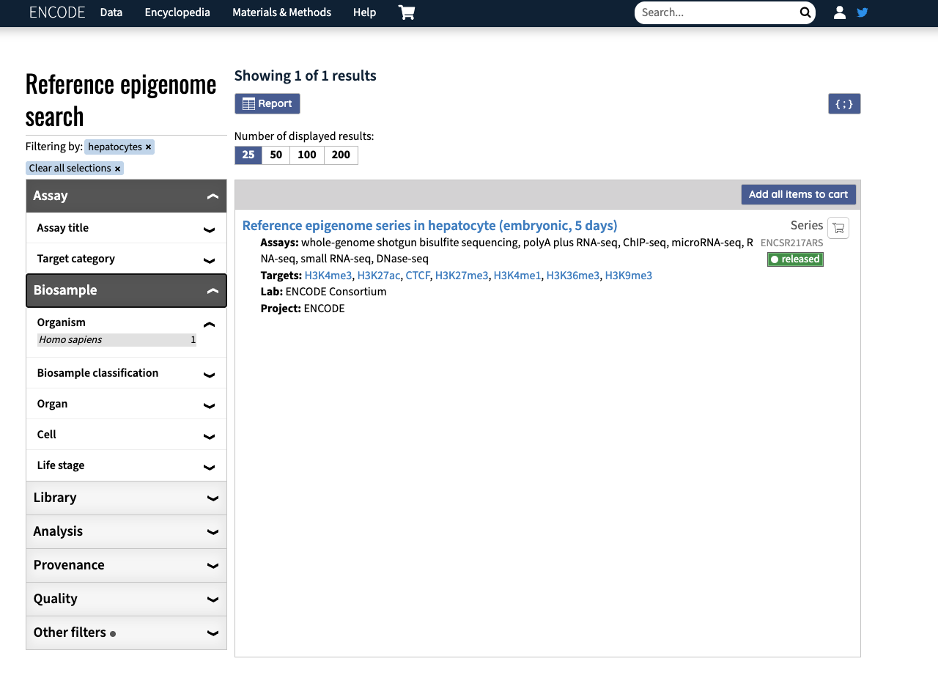
The ENCODE Data Portal
How many reference epigenomes for human hepatocytes are available?
1 reference epigenome

Slide 10
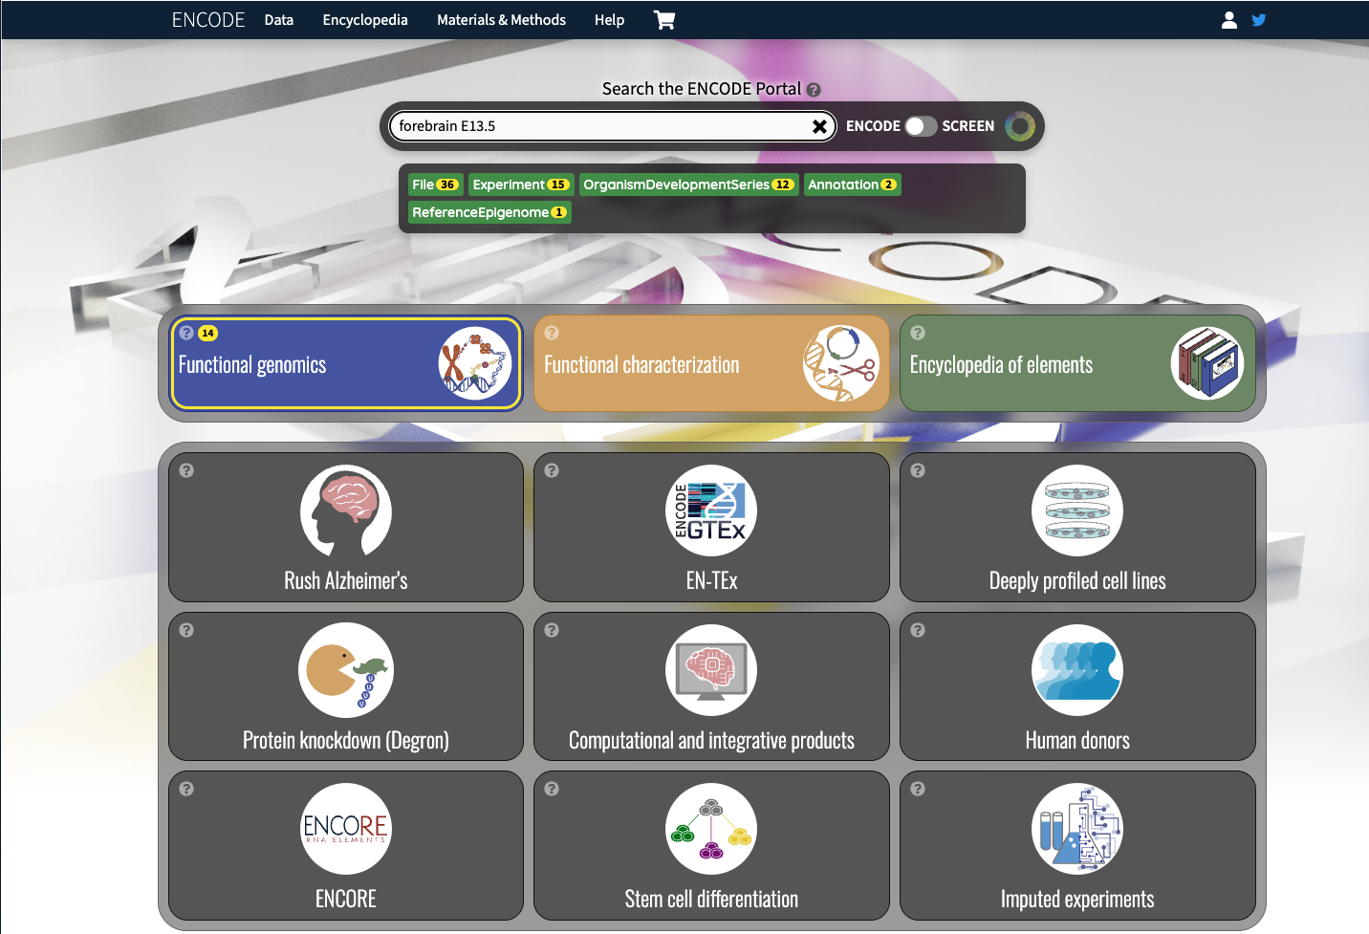
The ENCODE Data Portal
Using the search toolbar, query for forebrain E13.5 and select the available reference epigenomes. How many experiments do they have linked? Are there any open chromatin experiments available?
1 reference epigenome

Slide 11
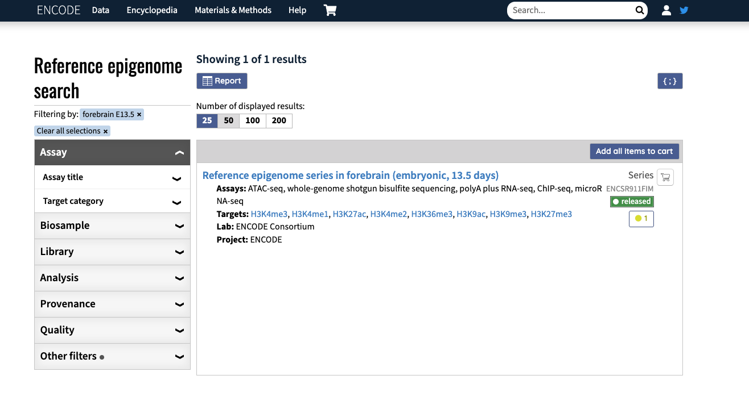
The ENCODE Data Portal
Using the search toolbar, query for forebrain E13.5 and select the available reference epigenomes. How many experiments do they have linked? Are there any open chromatin experiments available?

Slide 12
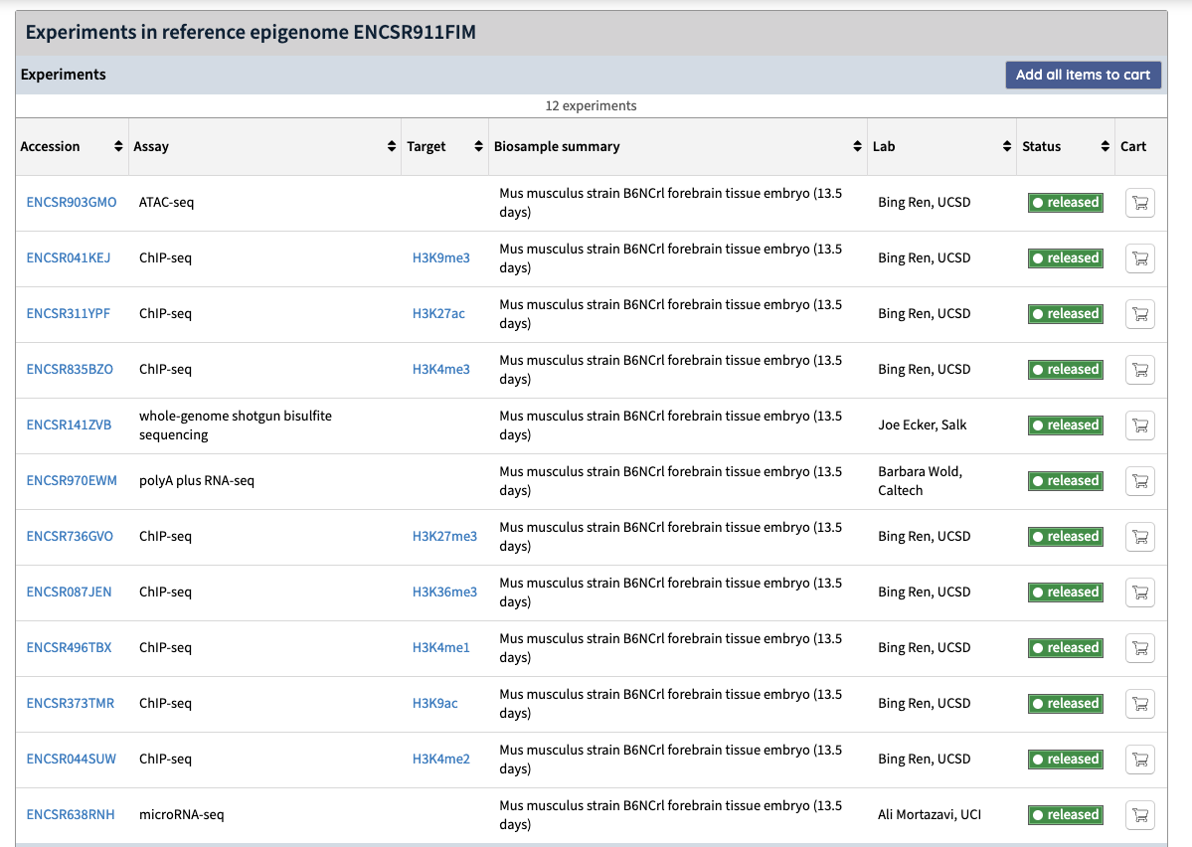
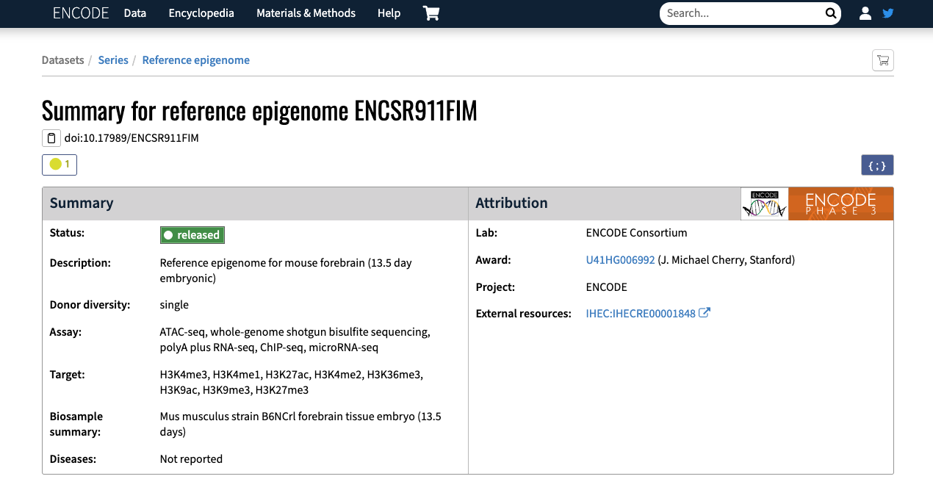
The ENCODE Data Portal
Using the search toolbar, query for forebrain E13.5 and select the available reference epigenomes. How many experiments do they have linked? Are there any open chromatin experiments available?
12 experiments

Slide 13
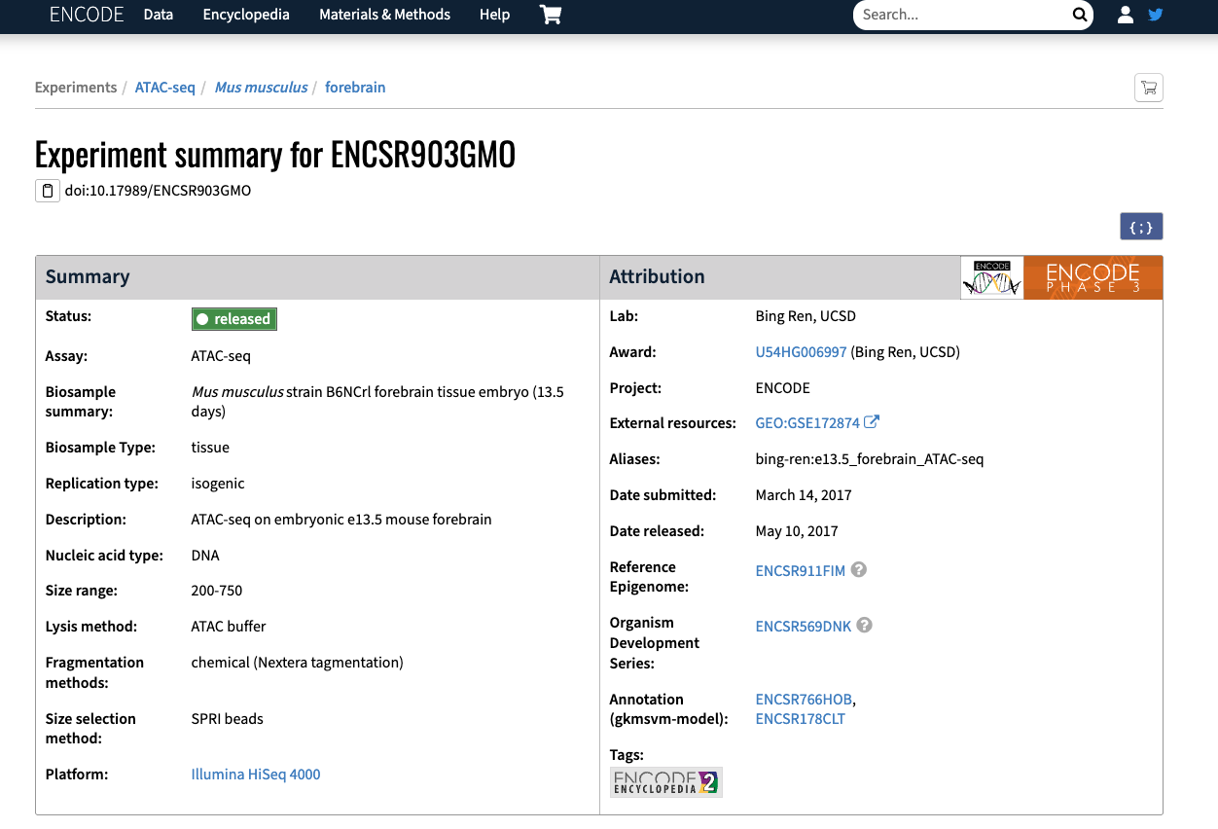
The ENCODE Data Portal
Using the search toolbar, query for forebrain E13.5 and select the available reference epigenomes. How many experiments do they have linked? Are there any open chromatin experiments available?
1 open chromatin (ATAC-seq) experiment

Slide 14
2
ENCODE cCREs and SCREEN

Slide 15
Hands-on

Slide 16
The ENCODE cCREs and SCREEN
Explore the indicated locus on SCREEN:
GRCh38, chr8:127,682,026-127,744,101
GRCm39/mm39, chr6:6,740,753-6,891,103; GRCm38/mm10 chr6:6,740,753-6,891,103
Inspect cCREs overlapping or near the indicated gene:
Human, MYC
Mouse, Dlx6
Review cCRE class, biosample support, and linked evidence for:
Human, HCT116 core collection
Mouse, Forebrain E13.5 ancillary collection

Slide 17

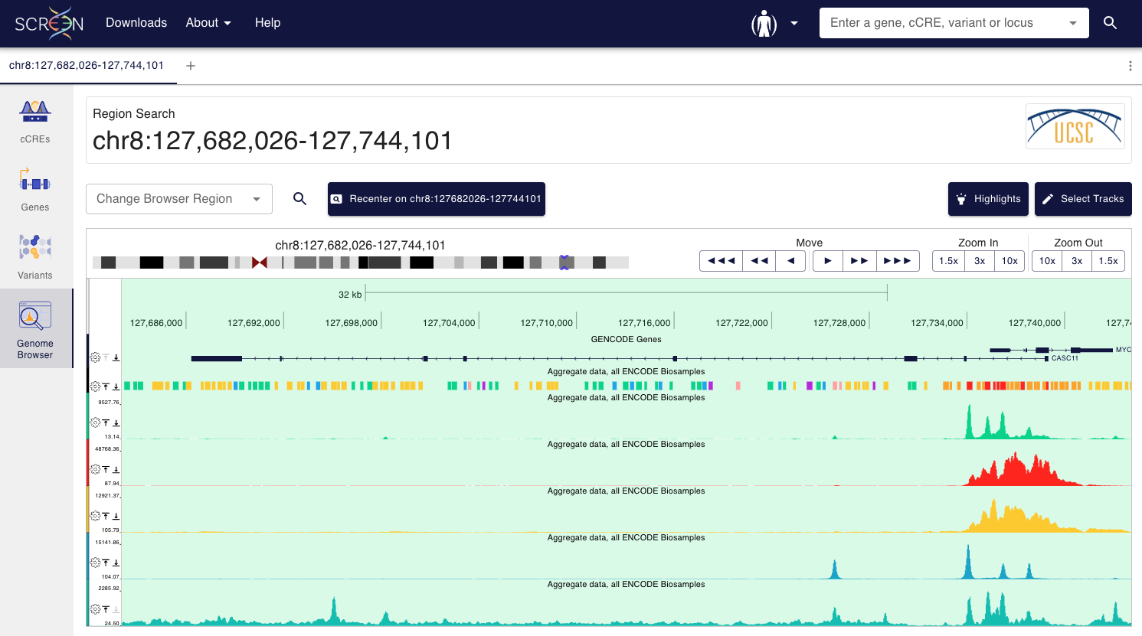
The ENCODE cCREs and SCREEN: GRCh38 locus

Slide 18
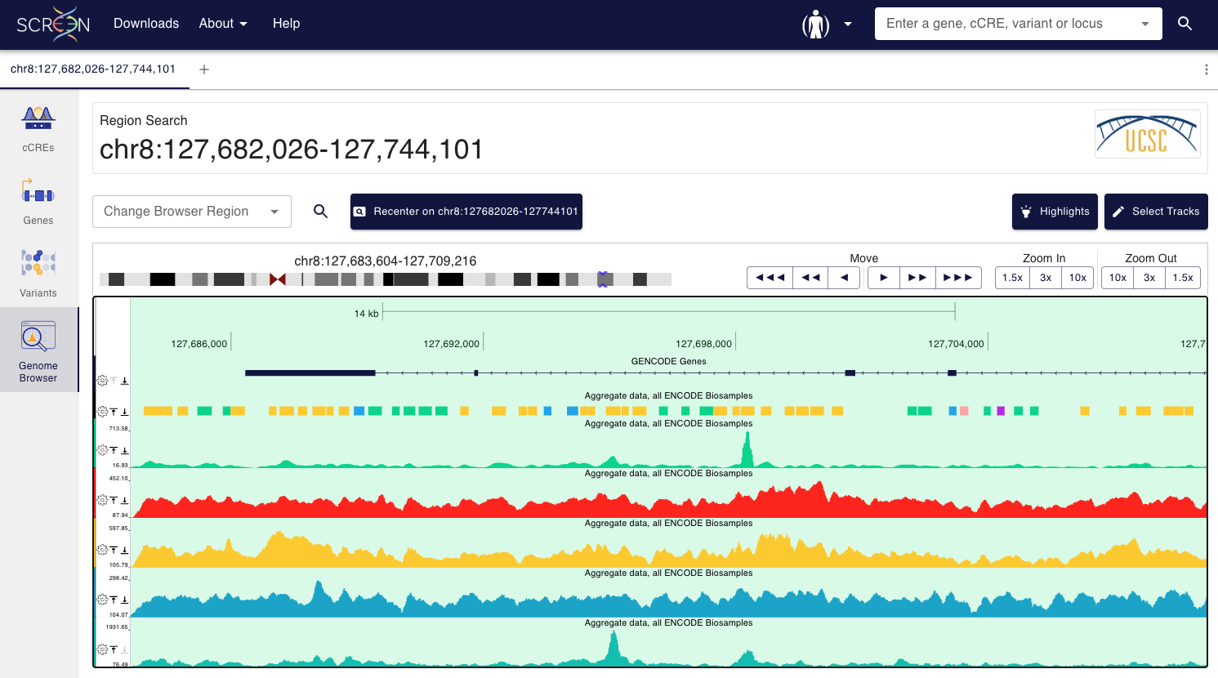
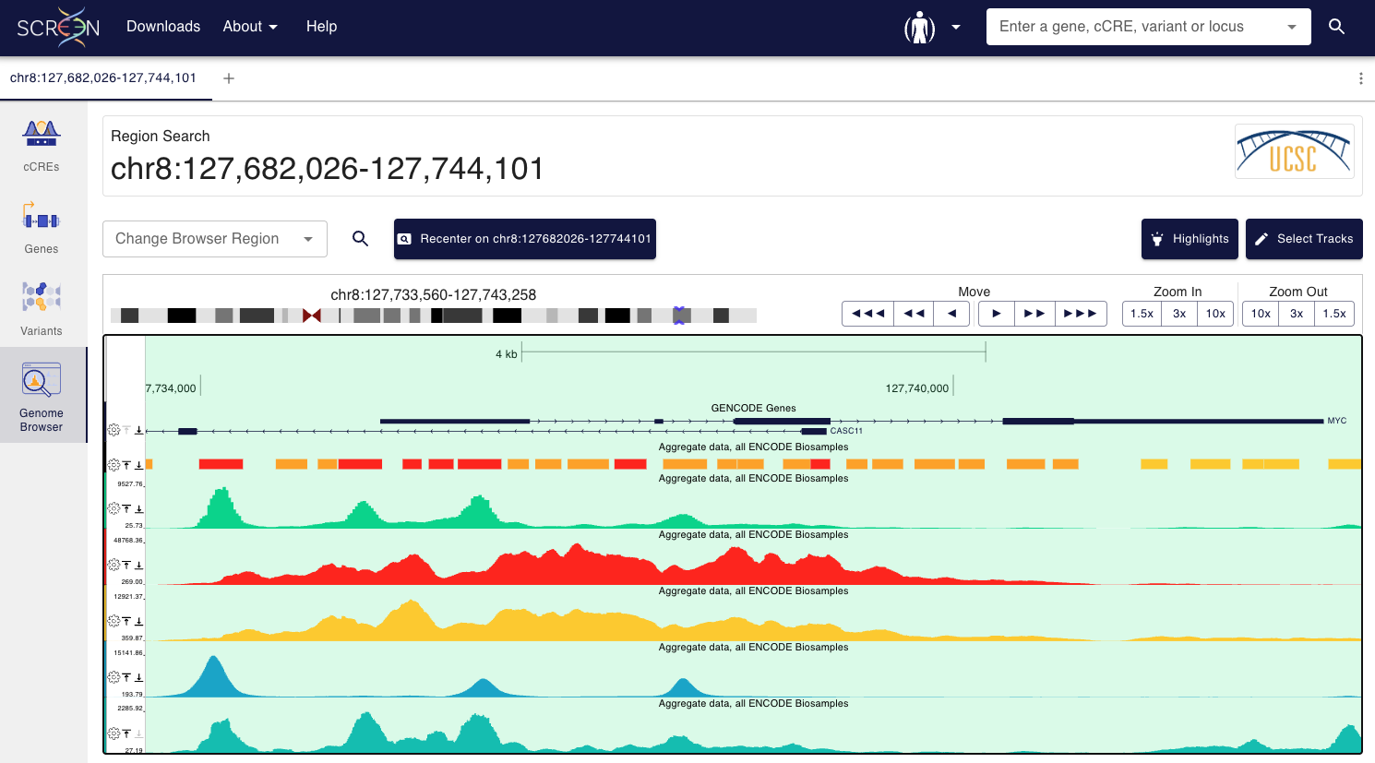
The ENCODE cCREs and SCREEN: GRCh38 locus

Slide 19
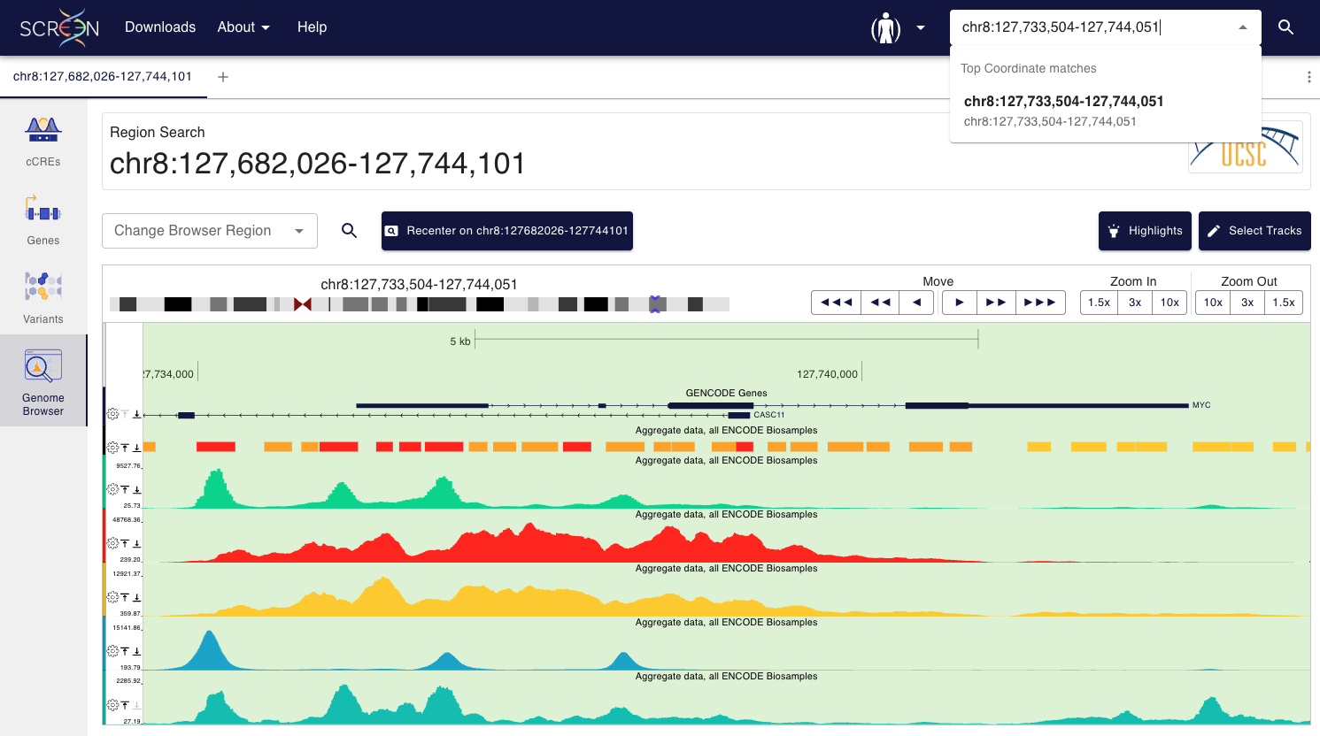
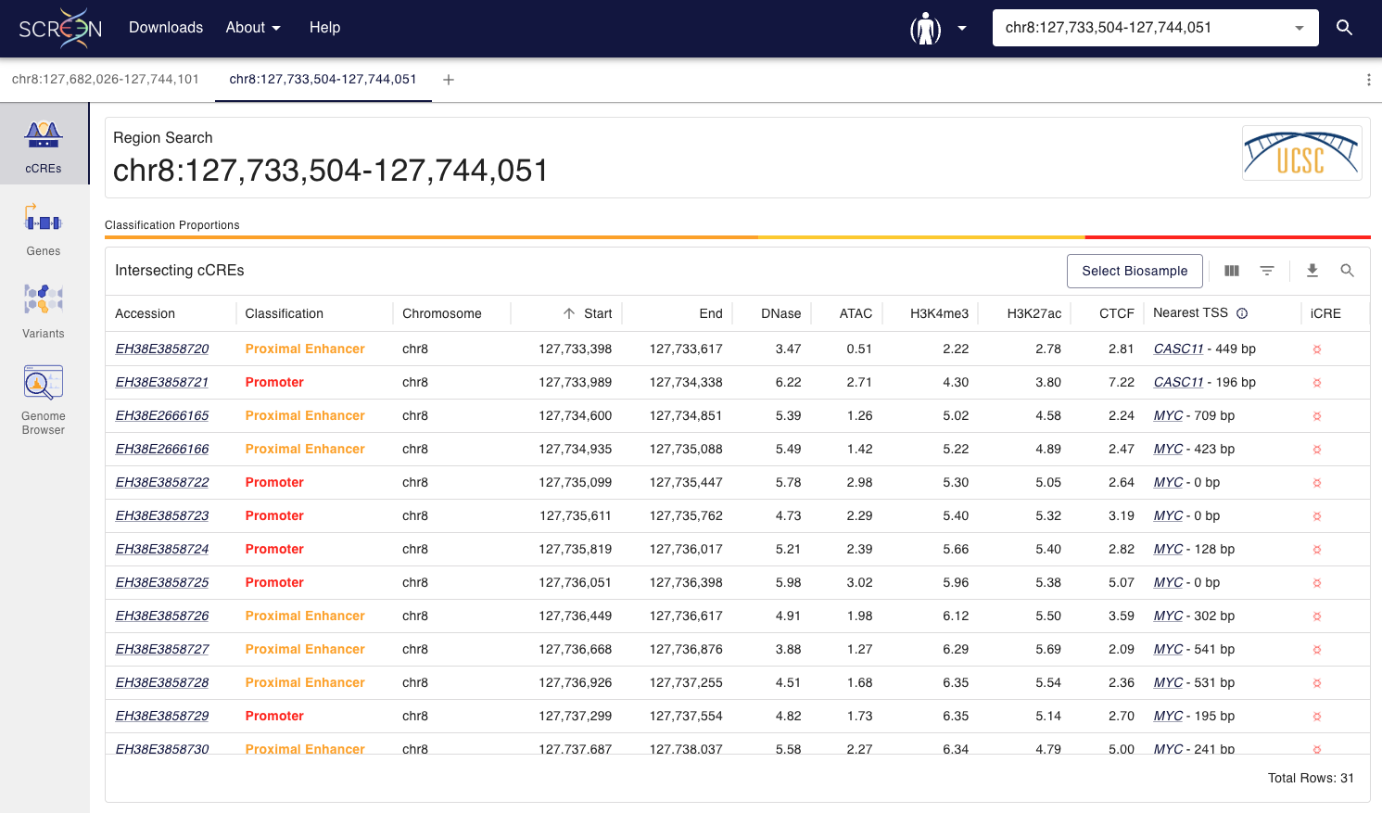
The ENCODE cCREs and SCREEN: MYC cCREs

Slide 20
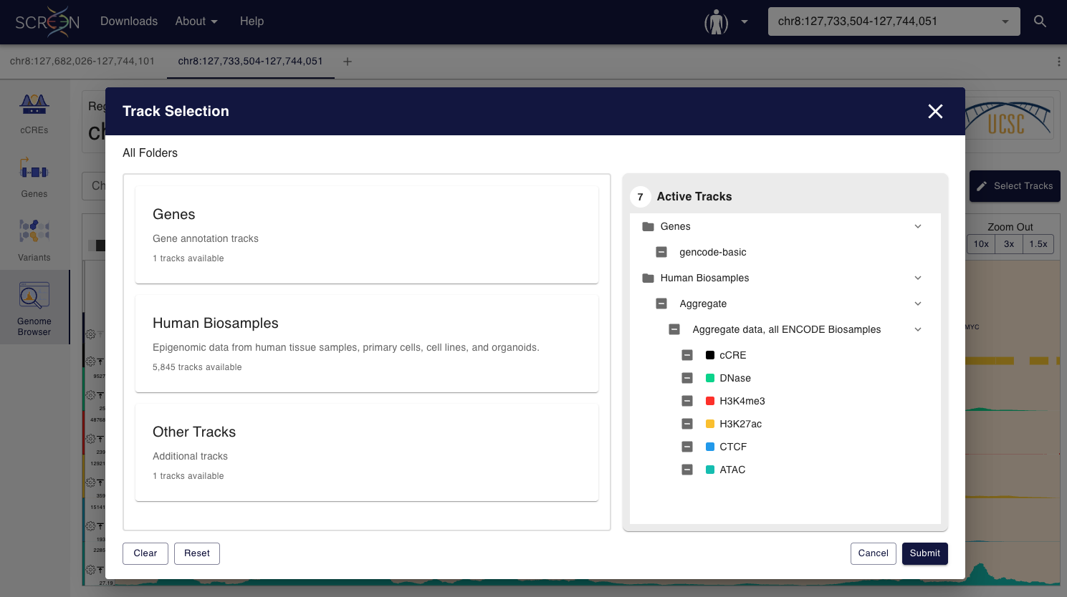
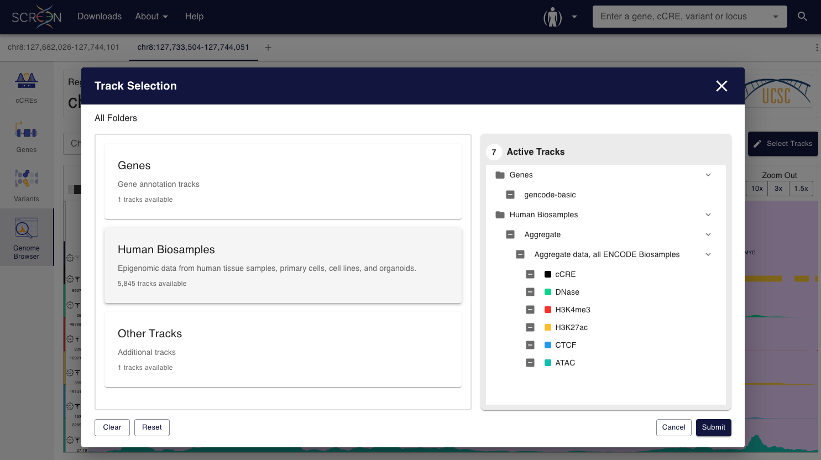
The ENCODE cCREs and SCREEN: HCT116

Slide 21
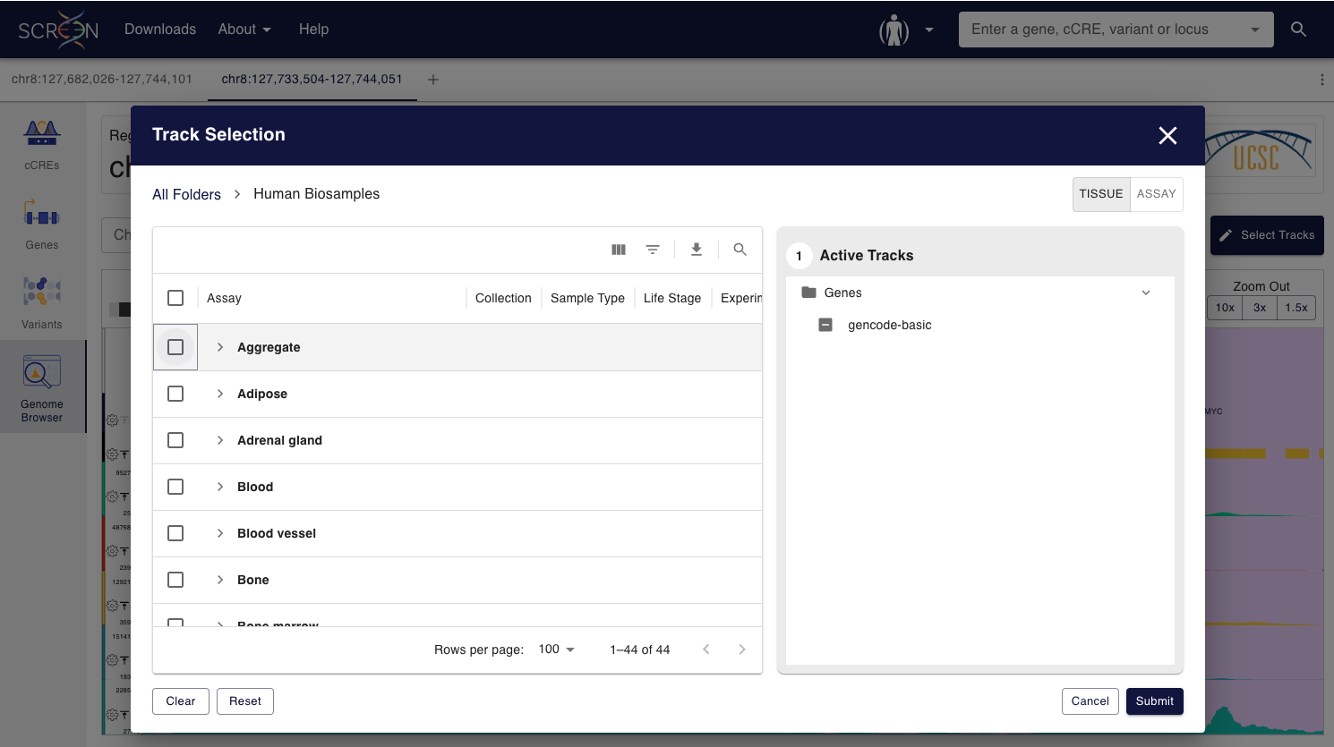
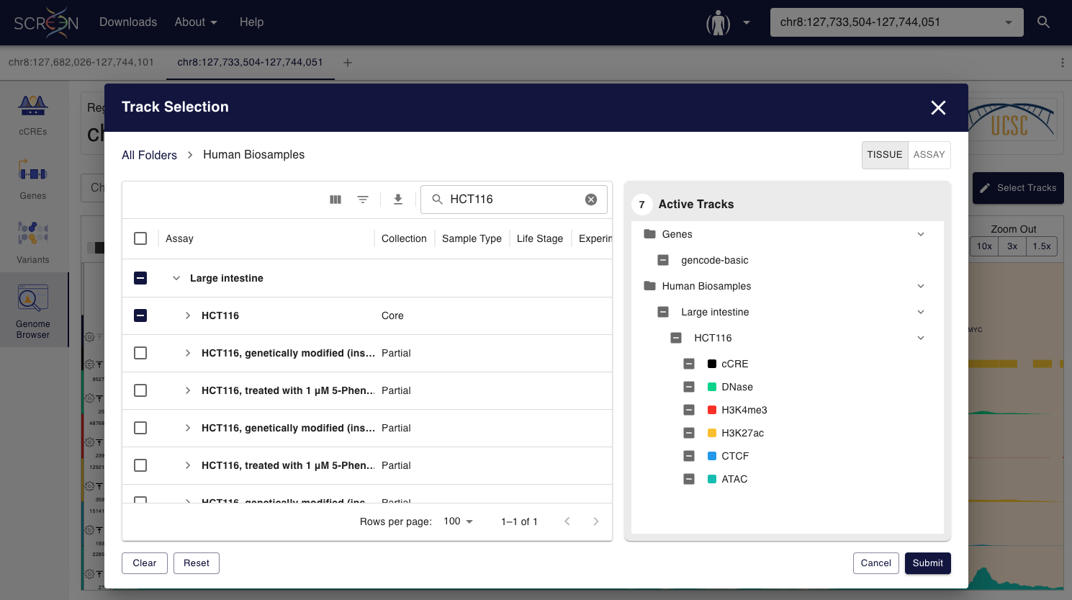
The ENCODE cCREs and SCREEN: HCT116

Slide 22
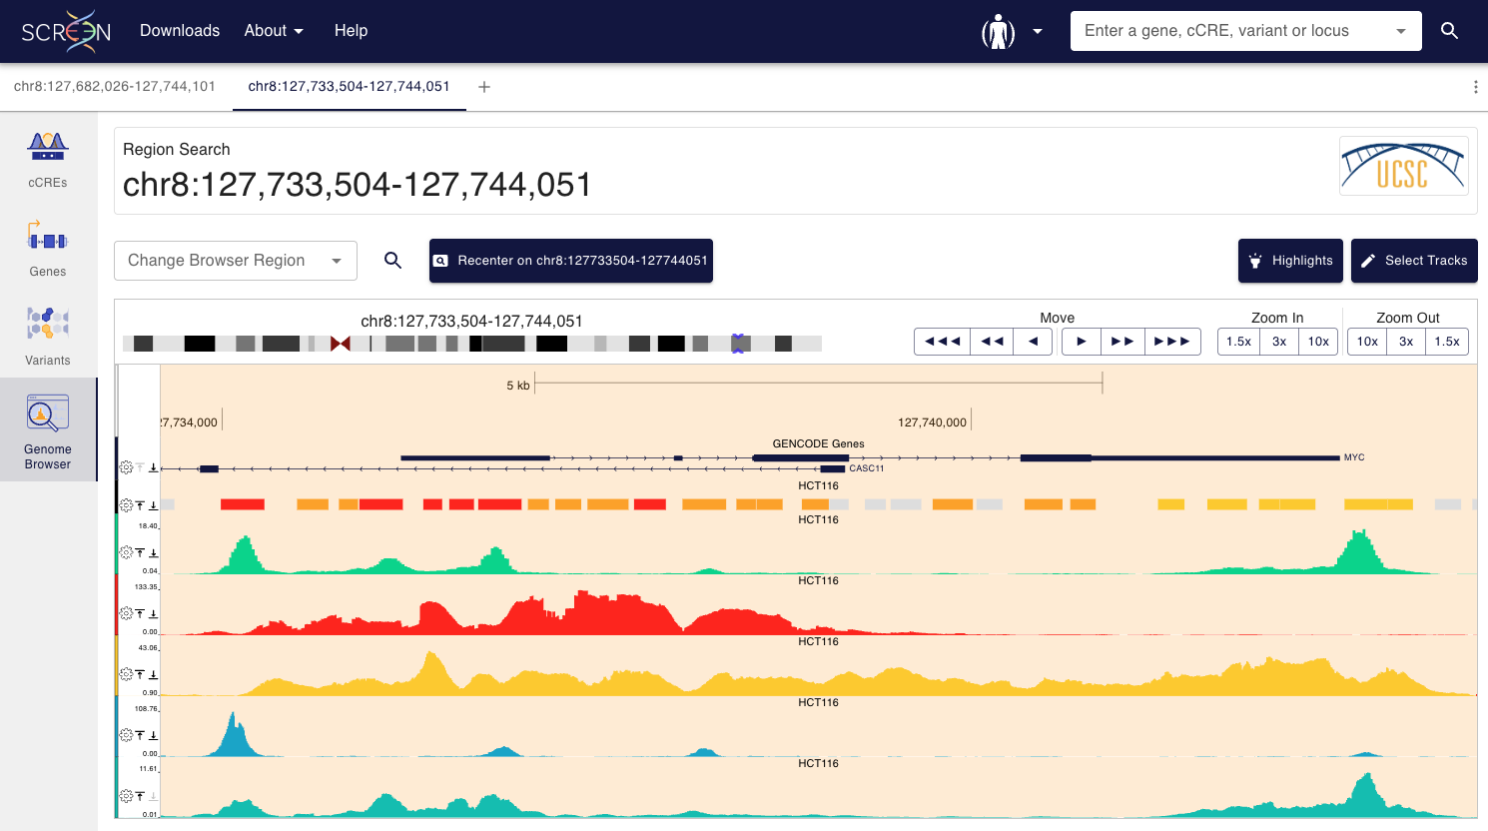
The ENCODE cCREs and SCREEN: HCT116

Slide 23
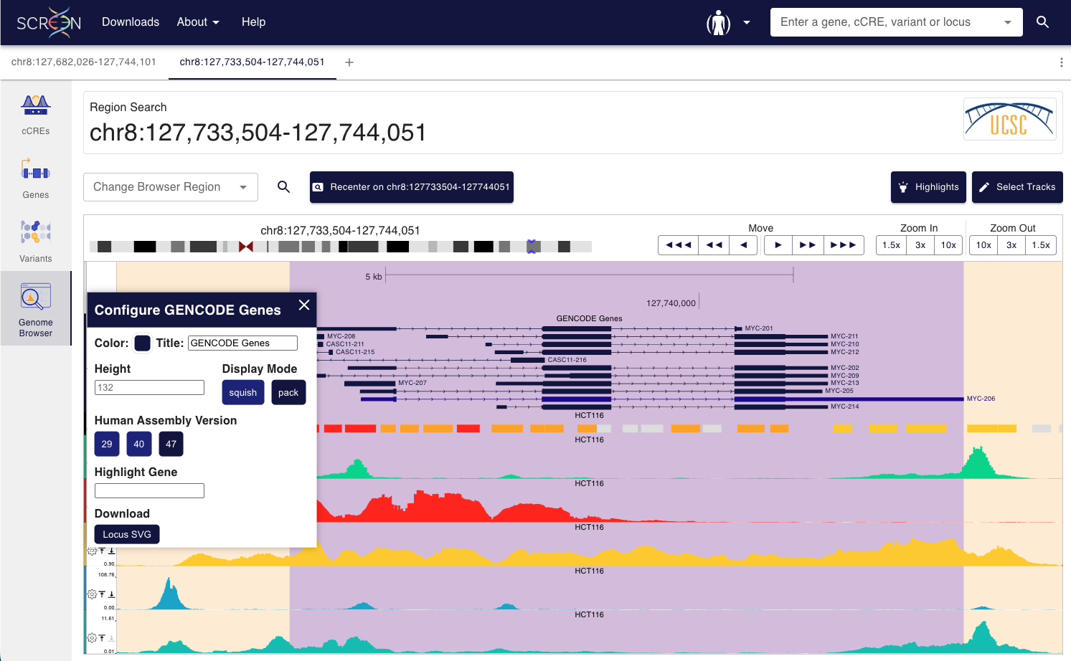
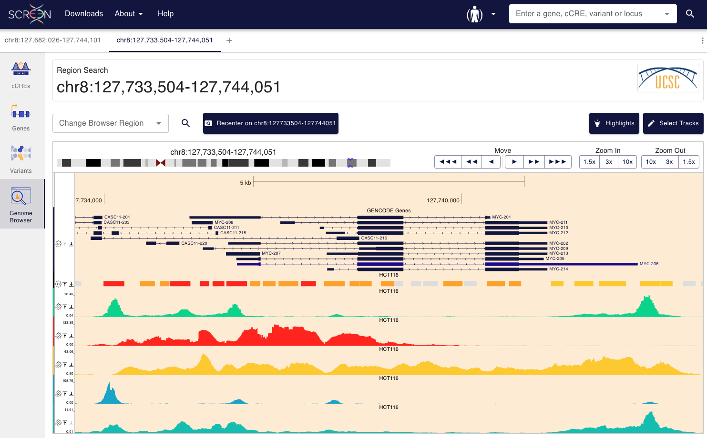
The ENCODE cCREs and SCREEN: HCT116

Slide 24
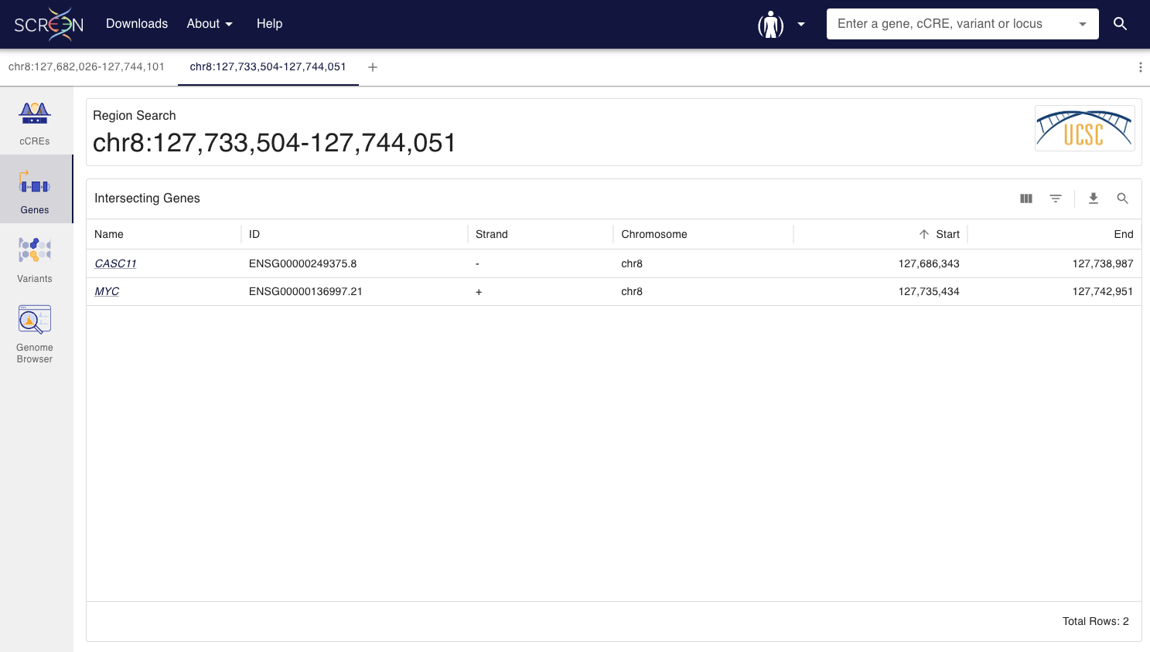
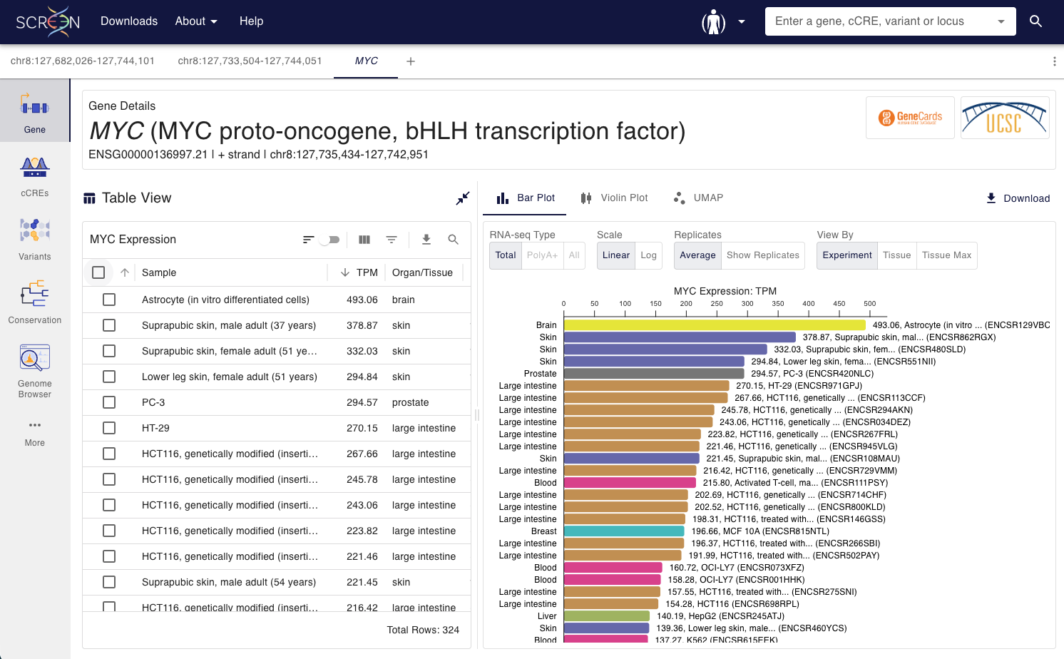
The ENCODE cCREs and SCREEN: HCT116

Slide 25
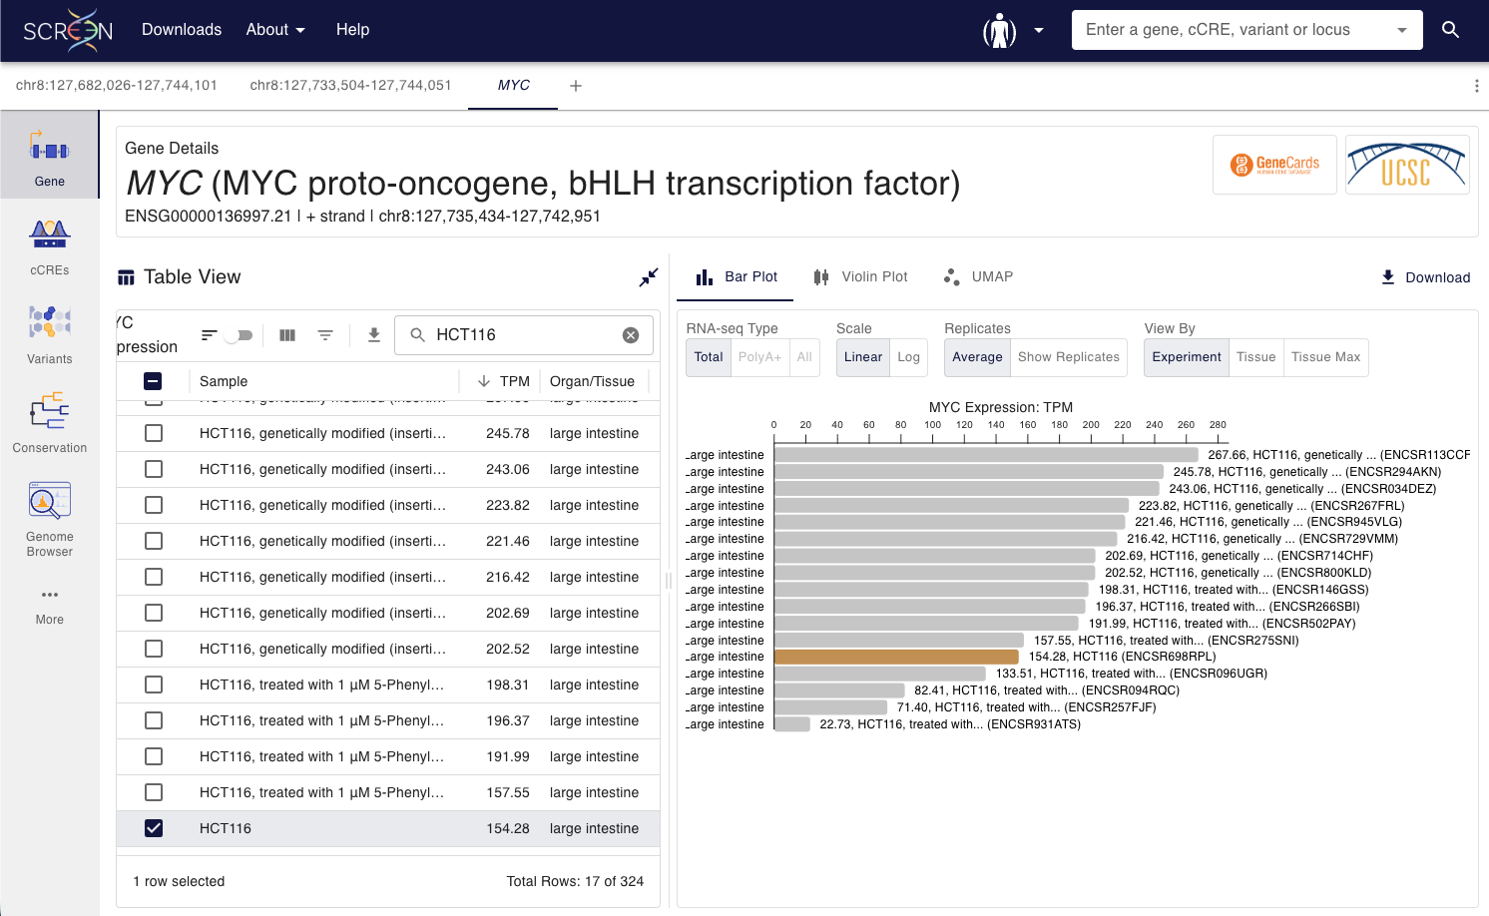
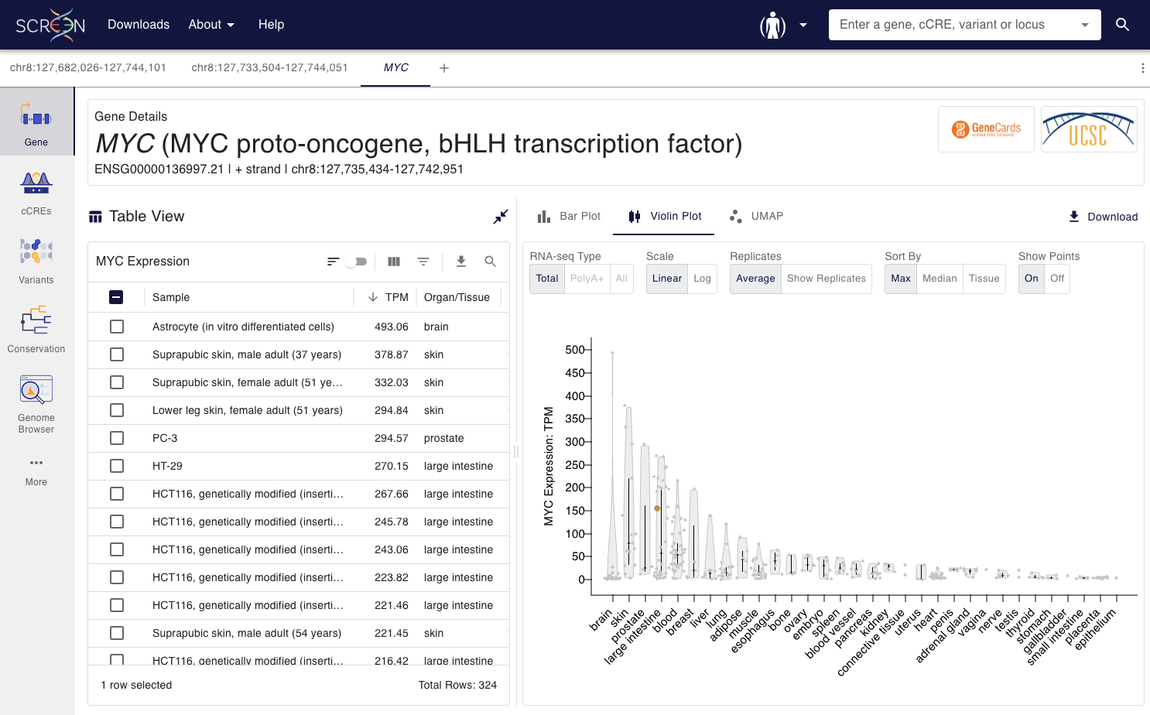
The ENCODE cCREs and SCREEN: HCT116

Slide 26
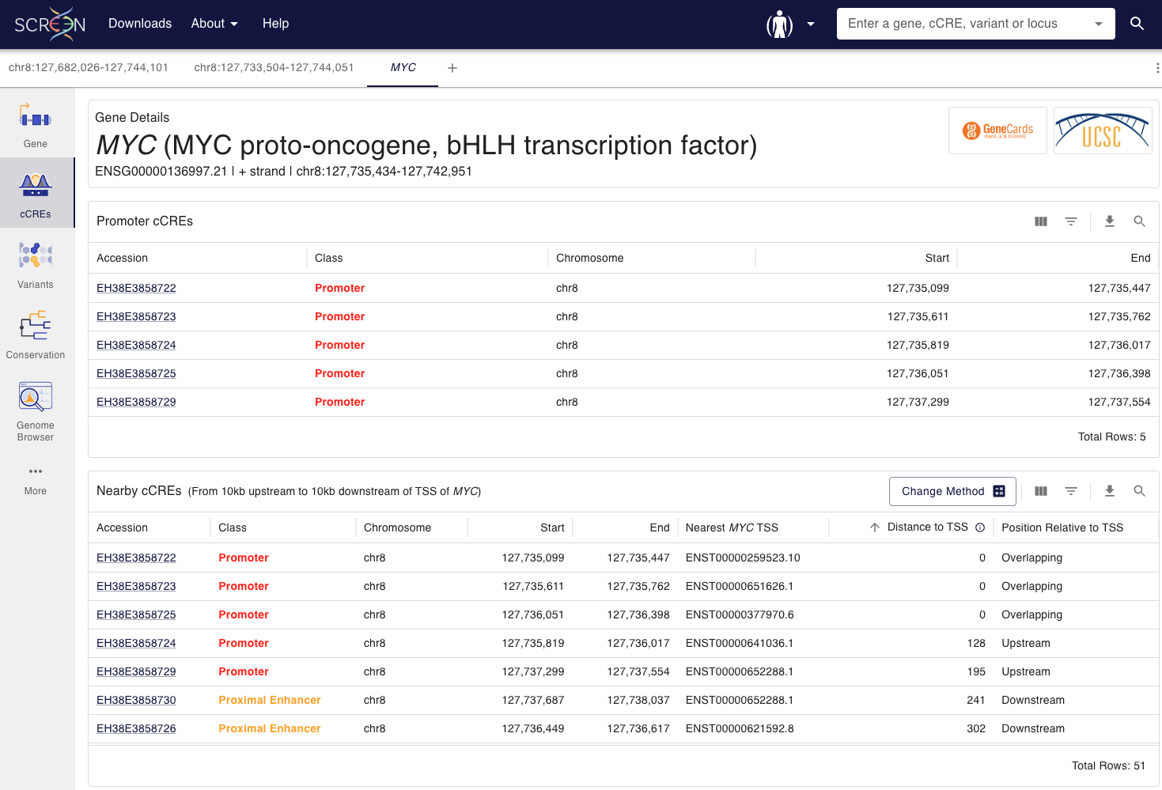
The ENCODE cCREs and SCREEN: HCT116

Slide 27
The ENCODE cCREs and SCREEN
Explore the indicated locus on SCREEN:
GRCh38, chr8:127,682,026-127,744,101
GRCm39/mm39, chr6:6,740,753-6,891,103; GRCm38/mm10 chr6:6,740,753-6,891,103
Inspect cCREs overlapping or near the indicated gene:
Human, MYC
Mouse, Dlx6
Review cCRE class, biosample support, and linked evidence for:
Human, HCT116 core collection
Mouse, Forebrain E13.5 ancillary collection

Slide 28
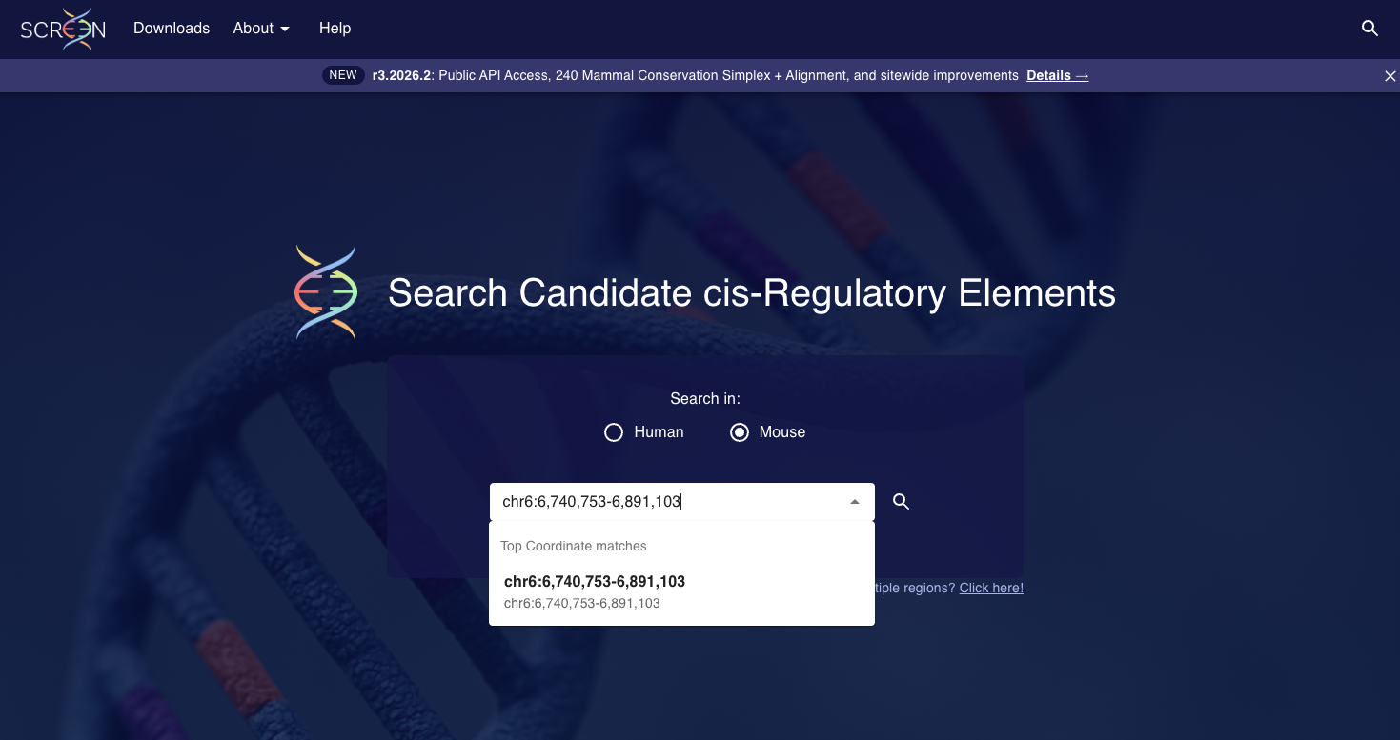
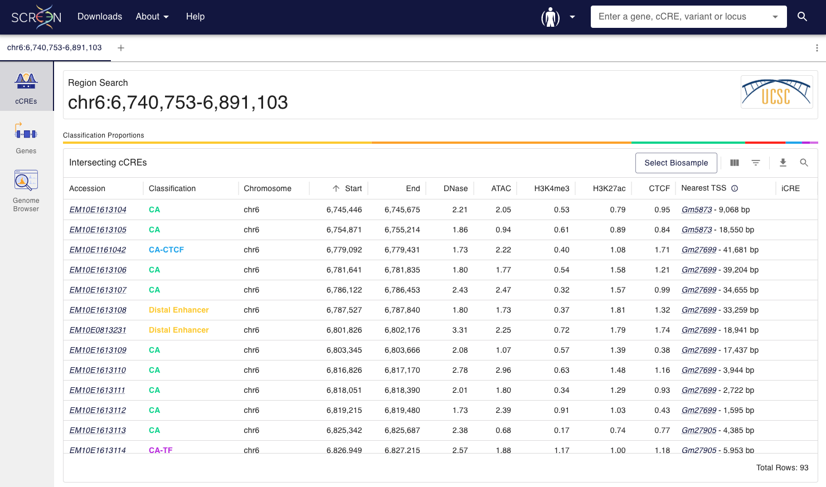
The ENCODE cCREs and SCREEN: mm10 locus

Slide 29
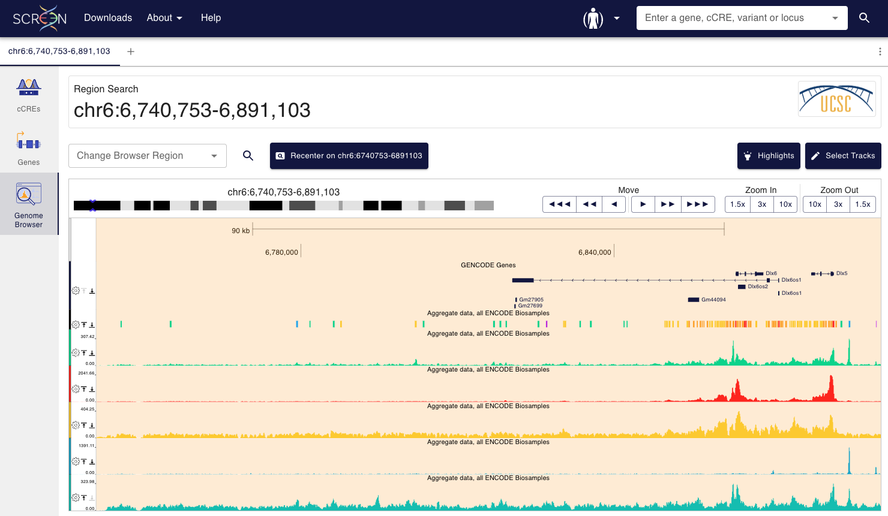
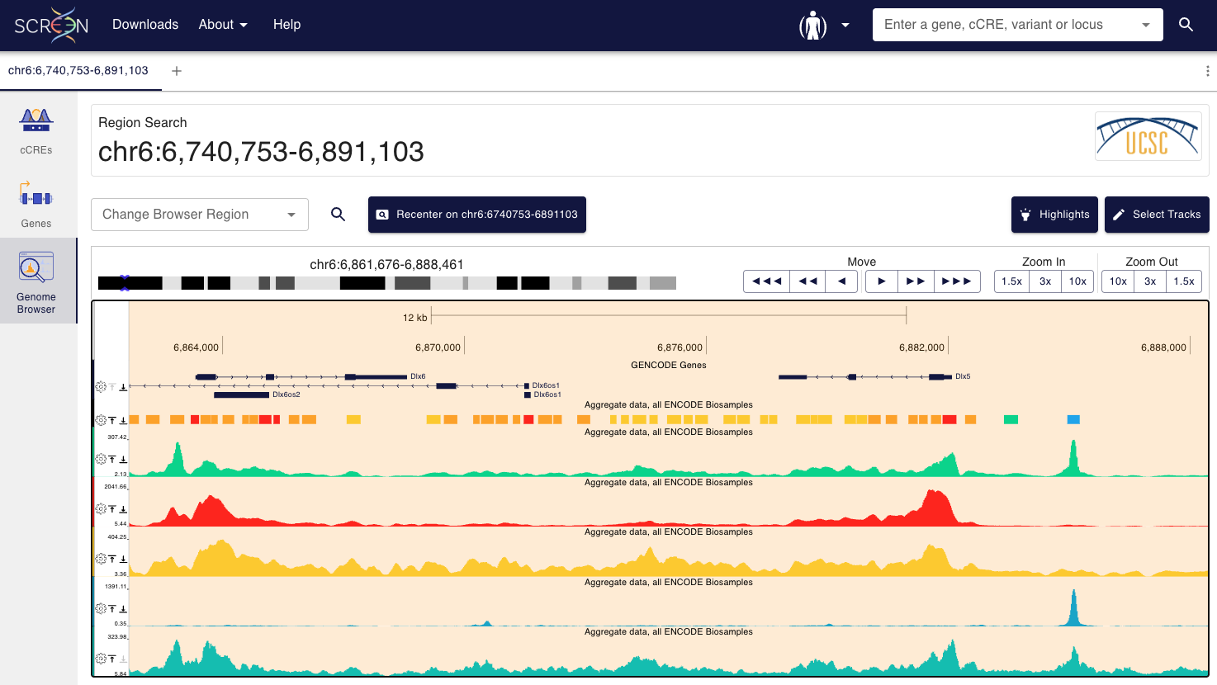
The ENCODE cCREs and SCREEN: mm10 locus

Slide 30
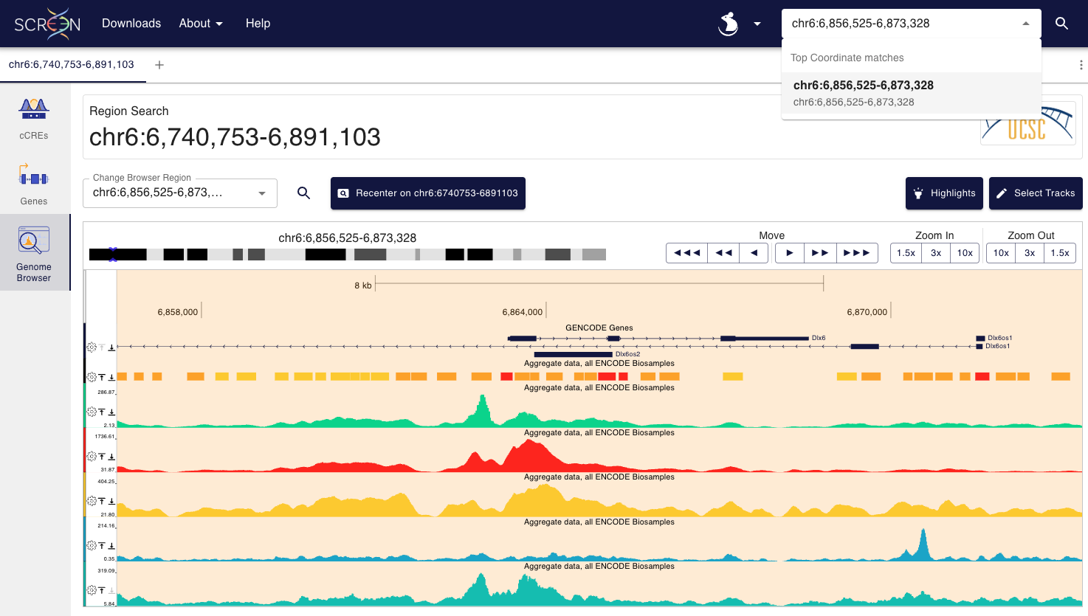
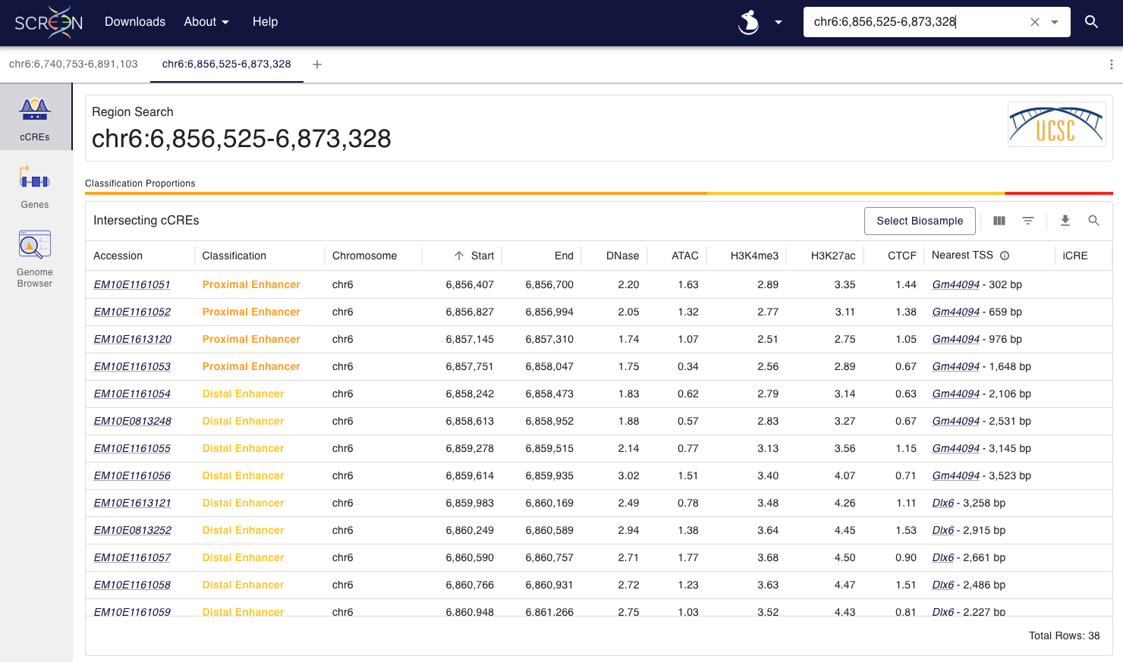
The ENCODE cCREs and SCREEN: Dlx6 cCREs

Slide 31
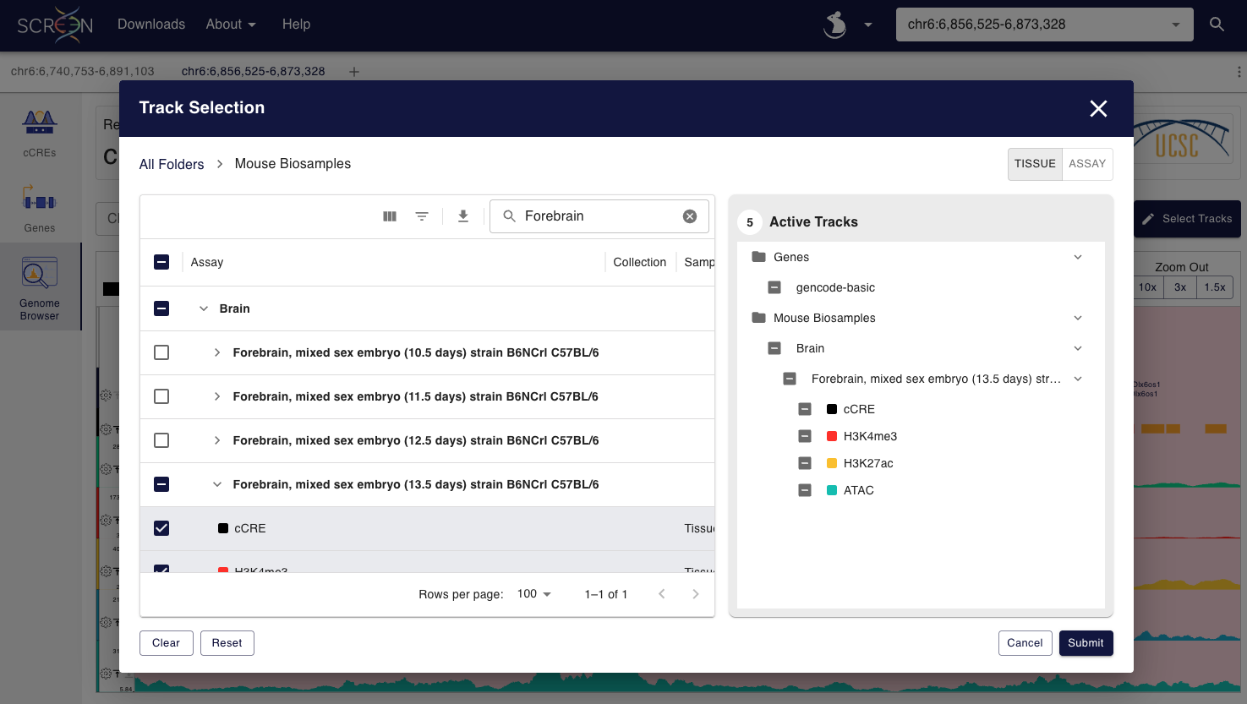
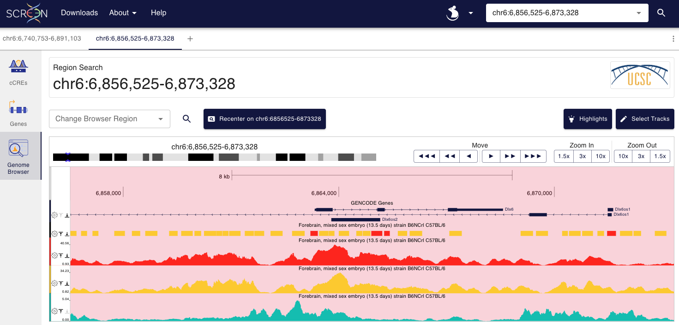
The ENCODE cCREs and SCREEN: Forebrain E13.5

Slide 32
The ENCODE cCREs and SCREEN: Forebrain E13.5

Slide 33
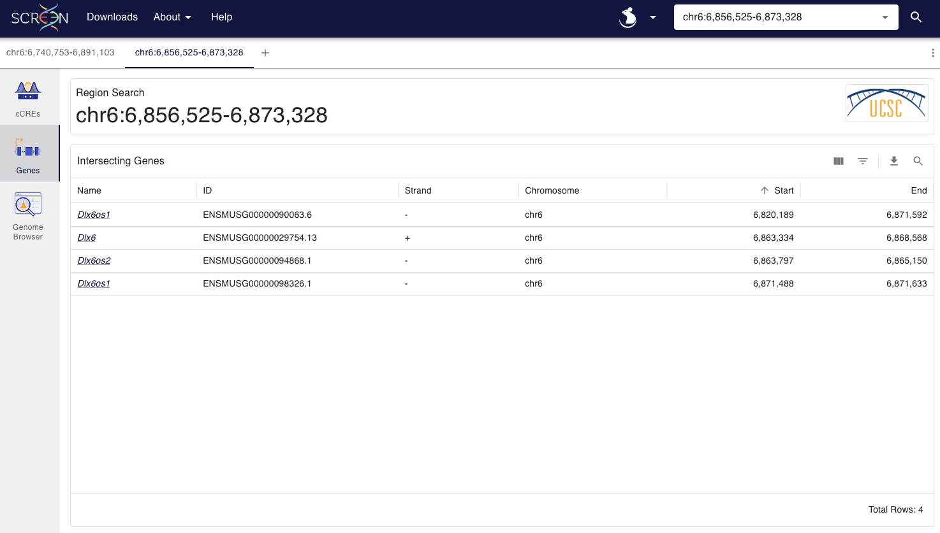
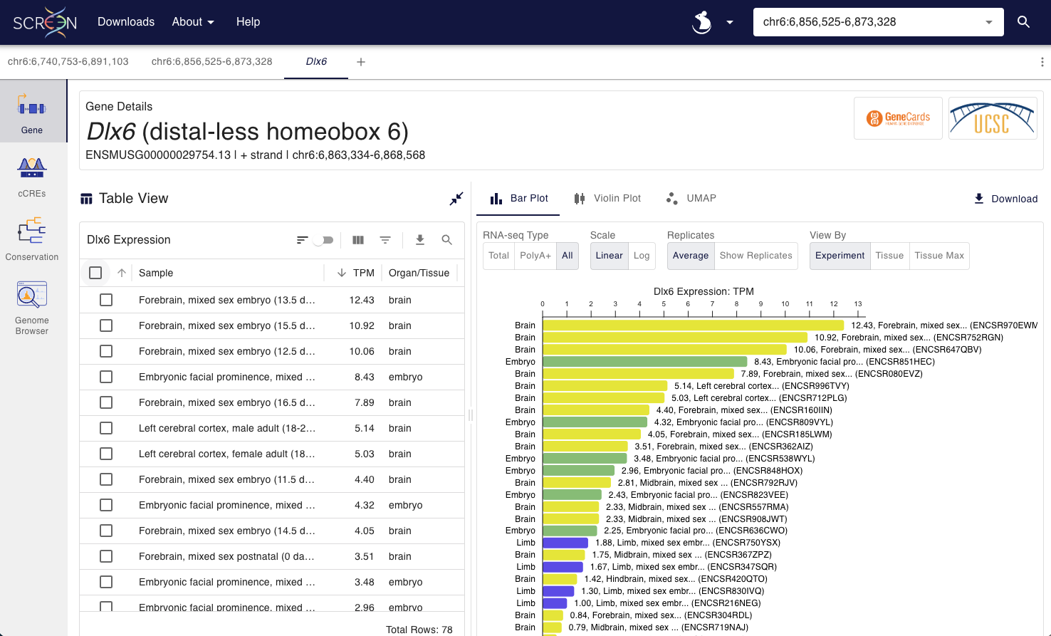
The ENCODE cCREs and SCREEN: Forebrain E13.5

Slide 34
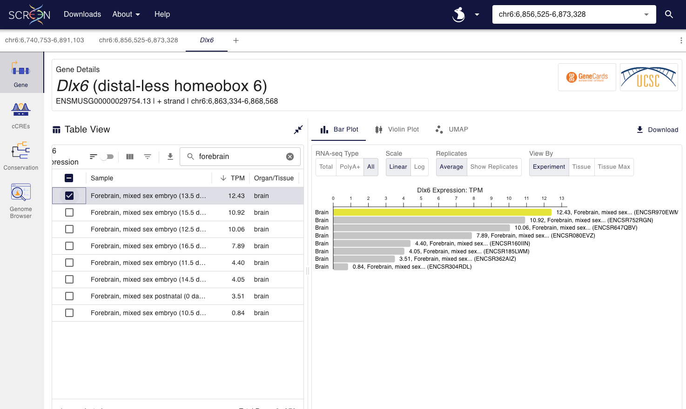
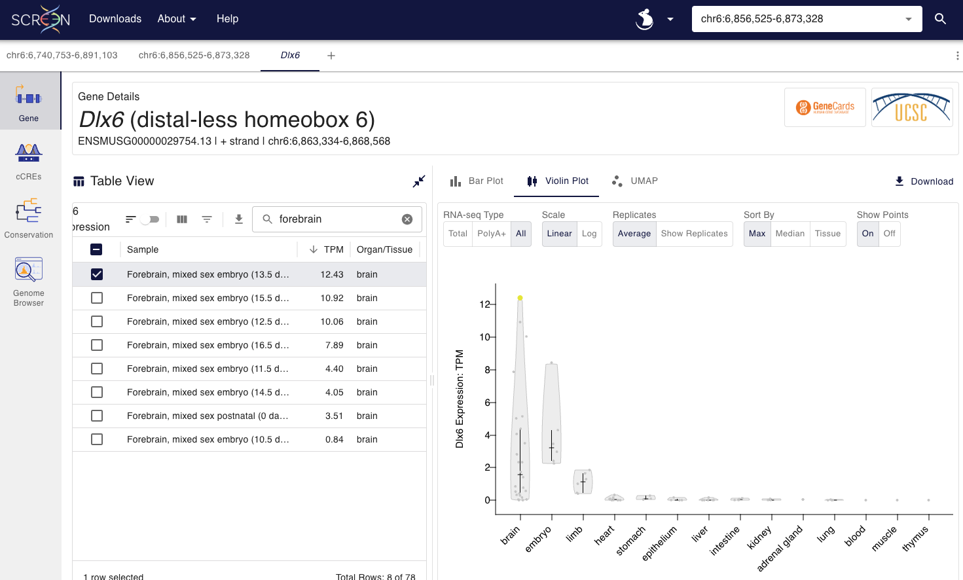
The ENCODE cCREs and SCREEN: Forebrain E13.5

Slide 35
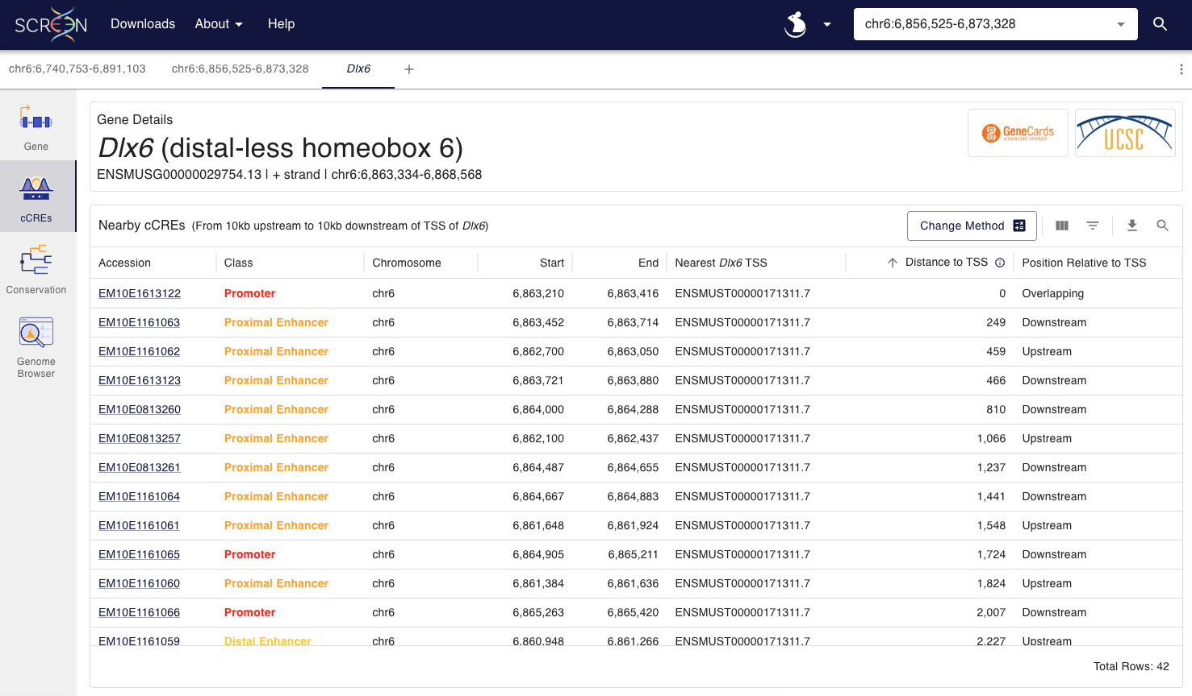
The ENCODE cCREs and SCREEN: Forebrain E13.5

